Slide 1
Boston Marathon 2025
Fundraising Social Toolkit
For Athletes
NOVEMBER 2024

Slide 2
About this toolkit
This toolkit is designed to help you make the most of your social media presence.
As you tell your story, drive donations, and spread awareness, these tips and creative assets will set you up for success. Following these best practices will help you engage your followers and make a meaningful impact for the charity online. Try to always keep your cause at the heart of your message, since that will inspire others the most to support your journey.

Slide 3
Top five ways to make an impact using social media
1 TELL YOUR STORY
Let's hear your powerful & authentic story. Share your journey by posting real running images on your feed, training moments and short video clips on your stories, etc. Be sure to inform your audience of the difference their donation will make to the cause you’re supporting.
2 BE RECOGNIZABLE
Change your profile picture (across social platforms) so people know who you are at a glance.
3 CONSISTENCY IS KEY
Post to your social media profiles regularly to get the best reach.
4 MAKE TAKING ACTION EASY
It's important to make it clear how you want people to respond to your post. Direct people to donate and include donation links whenever and wherever you can.
5 PRIORITIZE SHARING
Consider expanding your network by tagging your charity or notable people, in hopes they will re-share to help spread the word.

Slide 4
Crafting your story and social message
Your story matters. People want to hear about the reasons why you're running and what impact a donation will make for your charity. Think about 1-2 strong, short, captivating messages that you can use to draw people in. Add in details about your personal connection to your charity. If you don’t have something to add, reach out to the charity to gather stories to refer to. See examples below for inspiration.
Additionally, "My marathon is for [charity name]…" is consistent language being used in our campaign that can help showcase your charity, in a personal way.
“
My marathon is for Achilles International. And showing people that disabilities don't have to slow you down.
Not one bit.
“
Every mom wants to have a healthy baby
So my marathon is for Every Mother Counts.
And making sure all women have access
to quality maternity care.
CEDRIC K.
THERESE H.
“
I owe the people at St. Jude everything.
Because I'm 17 years cancer-free. My marathon
is for St. Jude. And helping all those kids with cancer who just wanna be kids again.
PHILIP A.

Slide 5
Storytelling Inspiration

Slide 6
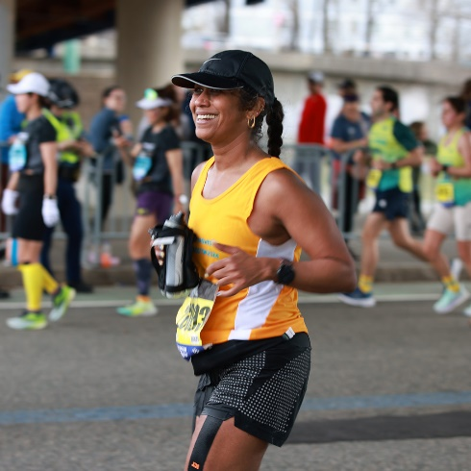
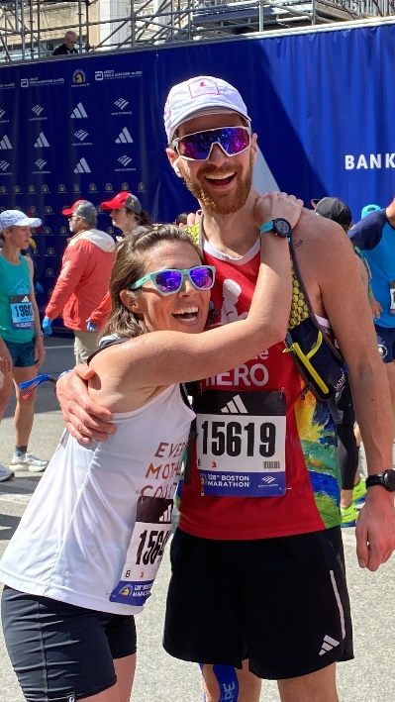





Showing your story through powerful running visuals
Select images and videos to use across your social channels to help tell your training and fundraising story. Based on different social platforms and formats, you may need to resize the image. Here are some of the most popular social sizes and cropped examples of each.
Will look best on:
Will look best on:
Facebook
(In-Feed only for a single or multi-image post)
X/Twitter
LinkedIn
Instagram
(In-Feed only for a single image or Carousel post)
Facebook
(Stories or Reels only)
Instagram
(Stories or Reels only)
TikTok
Square crop (1:1)
Vertical crop (9:16)

Slide 7
What should you include in your post?
When referring to the race, ensure to write it out as "the 129th Boston Marathon presented by Bank of America"
If space is limited with character count on social platforms, you can shorten Bank of America to "BofA"
You can also use tags, for example, on Instagram it would be "the 129th @bostonmarathon presented by @bankofamerica"
Tag or mention notable accounts associated with the race...and don't forget to include your charity!
Facebook: Bank of America, Boston Marathon, Boston Athletic Association
X/Twitter: @BankofAmerica, @BostonMarathon, @BAA
LinkedIn: Bank of America, Boston Athletic Association
Instagram: @bankofamerica, @bostonmarathon, @teambaa
TikTok: @boston_marathon
Use official hashtags associated with the race to help with discoverability and reach: #BostonMarathon & #Boston129
Add your GivenGain link to your social content as often as possible! If you need to shorten your link for character count on social platforms, try bit.ly - making an account is free!
For Instagram stories, please use the “Link Sticker” to drive people to your GivenGain. Avoid using the “Donation” sticker as it will direct people to donate to the overall charity vs. your specific fundraising effort.
If you are speaking in any video content captured, remember to add closed captions since most users watch with sound off.

Slide 8
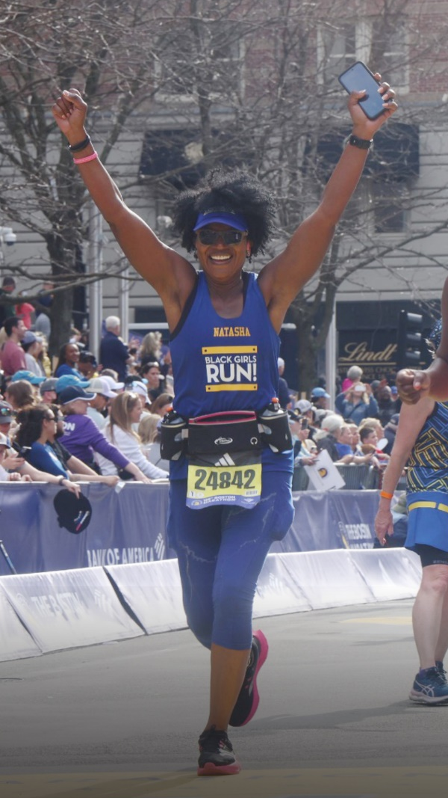
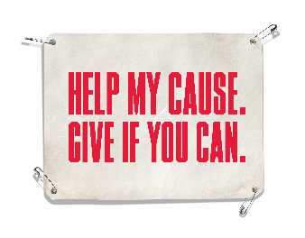
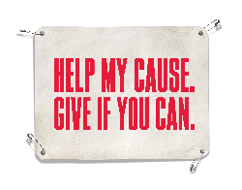
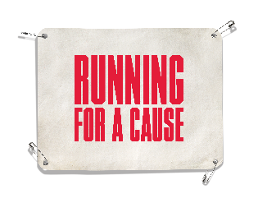

What should you include in your post?
You can also use any of the following GIPHYS on your Instagram Story posts. To include a GIF, tap then select ”GIF.”
You can search for Bank of America Boston Marathon stickers by searching the keyword, “boston marathon.”
YourSocialHandle
Bib Gif option 1
Hi friends! I’m running the
129th Boston Marathon in support of Project Purple.
Bib Gif option 2
Note: GIF Instagram stickers will be available in December 2024

Slide 9
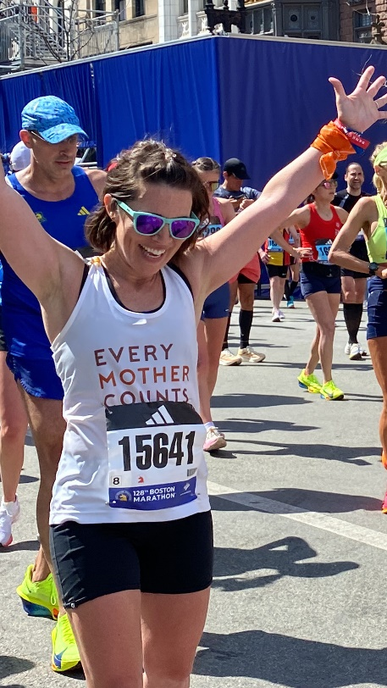
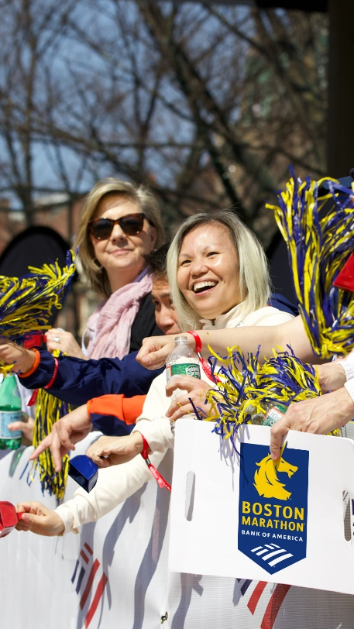
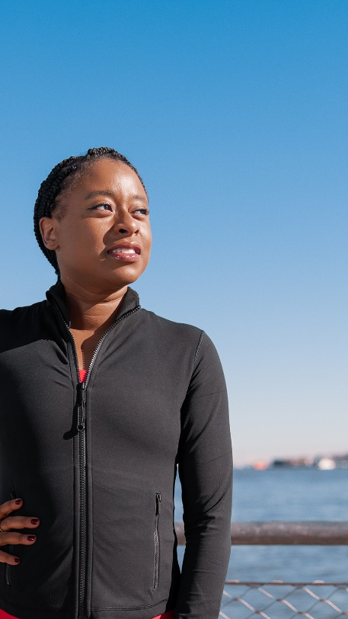
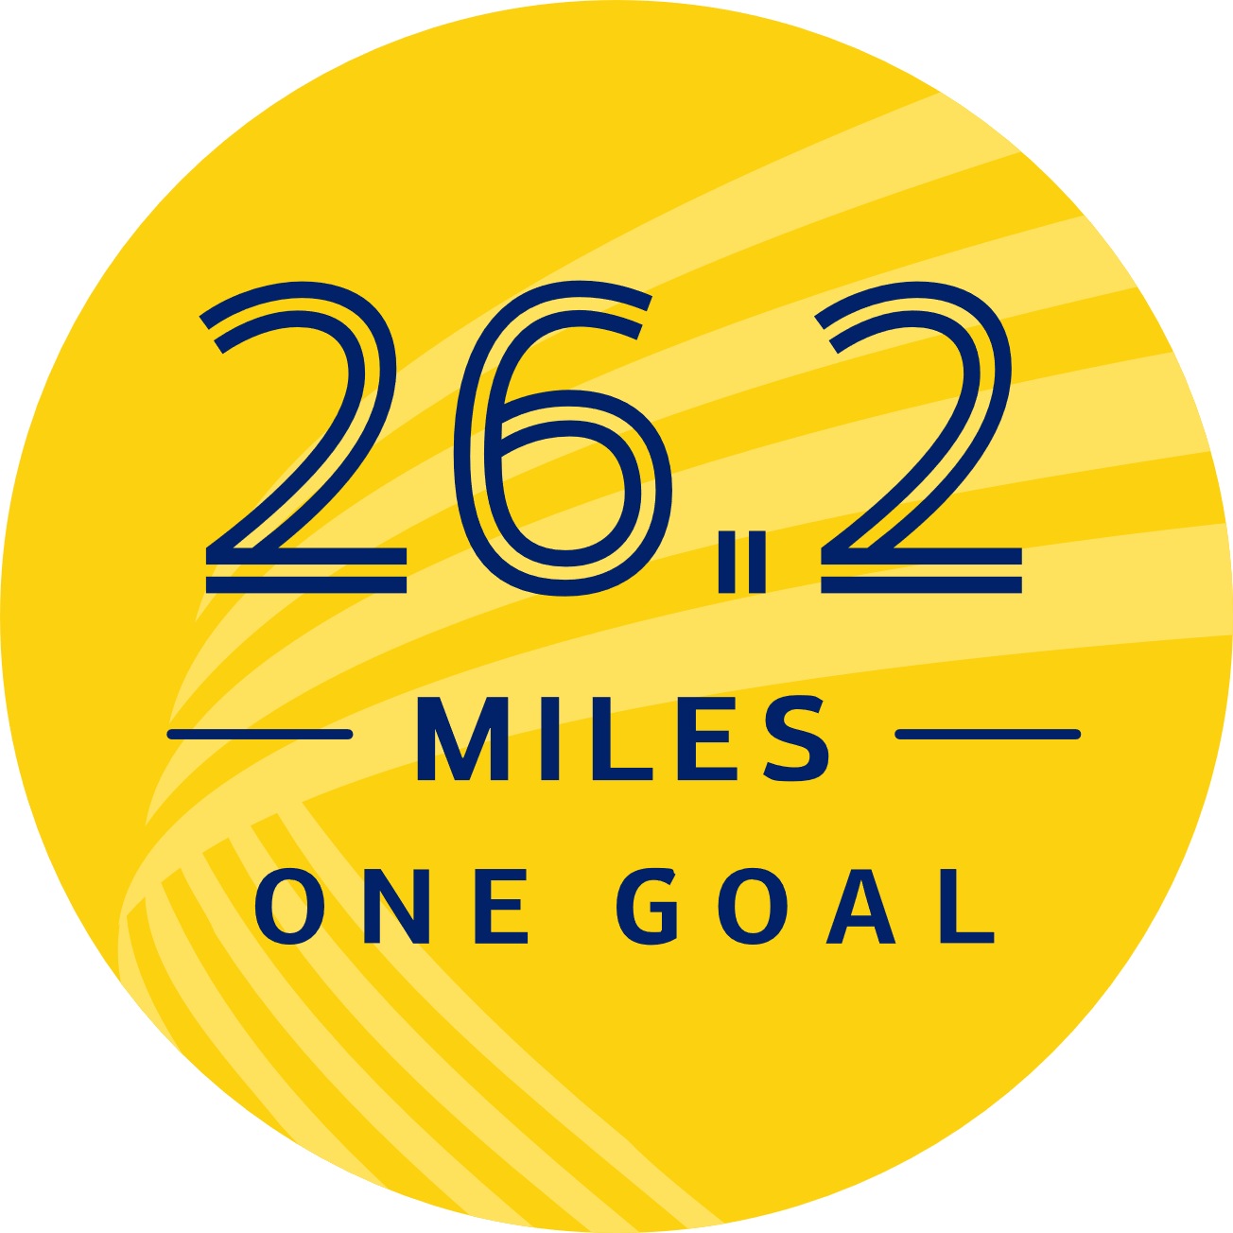





What should you include in your post?
You can also use any of the following GIPHYS on your Instagram Story posts. To include a GIF, tap then select ”GIF.”
You can search for Bank of America Boston Marathon stickers by searching the keyword, “boston marathon.”
Inspiring Quotes
YourSocialHandle
YourSocialHandle
YourSocialHandle
I’m running the Boston Marathon presented by Bank of America in support of Every Mother Counts.
5,000
^ Shows up white (no background), overlaid on photos. Great for legibility & usage in this space.
Help me reach my fundraising goal in support of Semper Fi!
Let’s make an impact together!
Support my run for St. Jude in this years Boston Marathon.
Help me get my fundraising goal over the finish line!
Note: GIF Instagram stickers will be available in December 2024

Slide 10
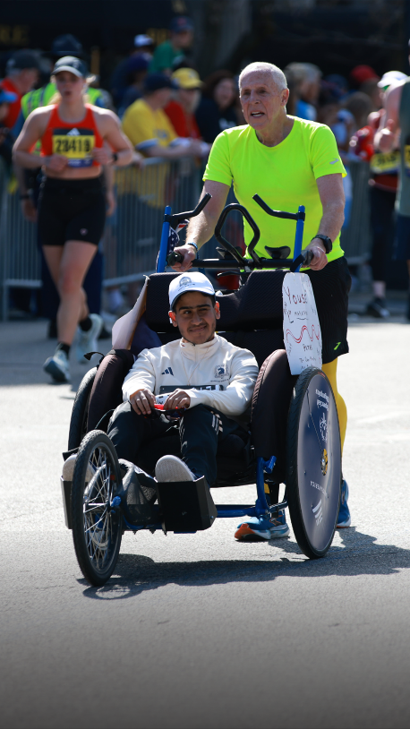
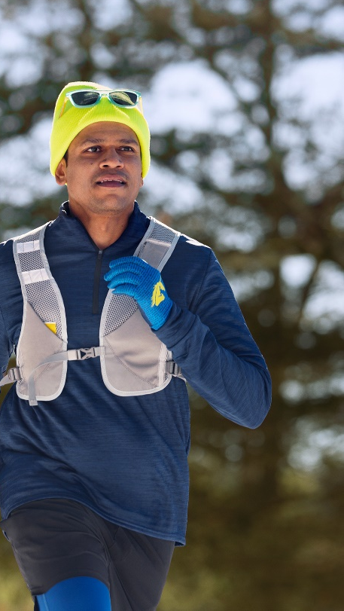
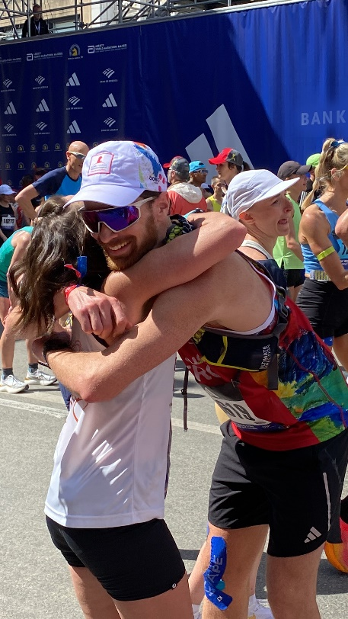
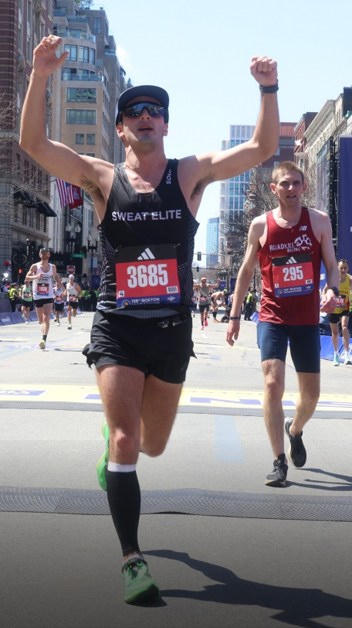





What should you include in your post?
You can also use any of the following GIPHYS on your Instagram Story posts. To include a GIF, tap then select ”GIF.”
You can search for Bank of America Boston Marathon stickers by searching the keyword, “boston marathon.”
Inspiring Quotes
YourSocialHandle
YourSocialHandle
YourSocialHandle
YourSocialHandle
Help me get my fundraising goal over the finish line!
^ Shows up white (no background), overlaid on photos. Great for legibility & usage in this space.
Note: GIF Instagram stickers will be available in December 2024
10

Slide 11






What should you include in your post?
You can also use any of the following GIPHYS on your Instagram Story posts. To include a GIF, tap then select ”GIF.”
You can search for Bank of America Boston Marathon stickers by searching the keyword, “boston marathon.”
YourSocialHandle
Logo Gif
As many of you may already know, I’m running the Boston Marathon to support the American Heart Association in memory of my Mom ❤️
Please consider donating toward my cause!
FRAME 1
Unicorn starts to appear
FRAME 2
Unicorn continues to animate, shrink and rise, while flagscape starts to animate
FRAME 3
New logo is revealed
Note: GIF Instagram stickers will be available in December 2024

Slide 12
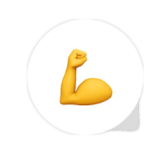
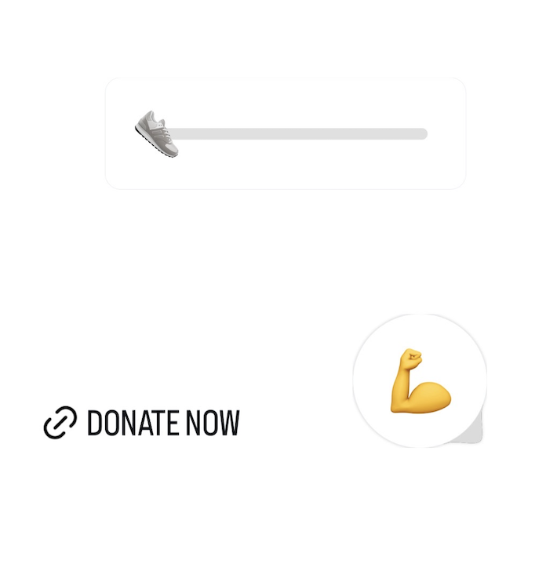
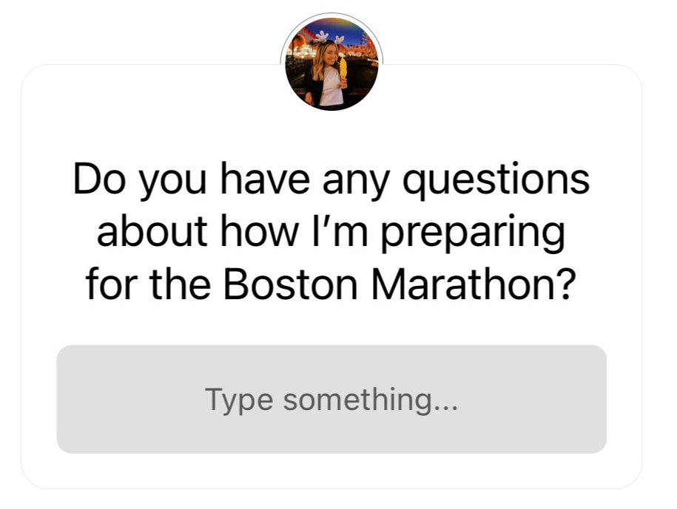


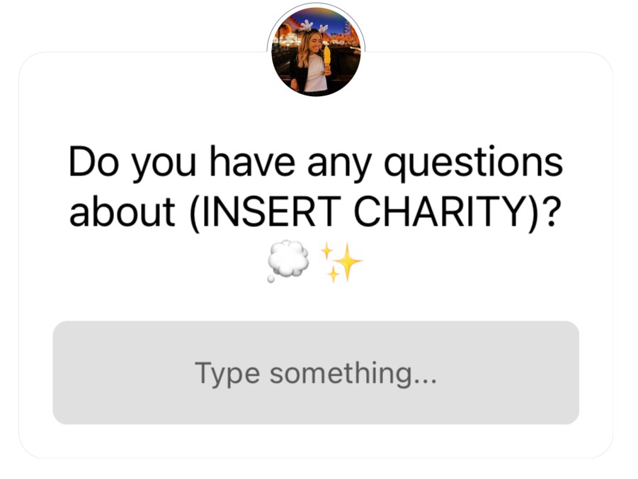
What should you include in your post?
When creating Instagram stories, you can also include question boxes, emoji sliders, reaction or link stickers. You can find any of these options by selecting then click the sticker type you’d like to use. Adding interactive elements to your posts can help drive engagement and help your audience feel more involved in your content.
Emoji Slider Sticker
Emoji Reaction Sticker
Link Sticker
Question Sticker
REMINDER: Please use a “Link Sticker” to drive people to your GivenGain and avoid using “Donation” stickers

Slide 13
Instagram caption templates
If you’re in need of caption inspiration, feel free to use the caption templates below and add your own person information to the fields in red. Note: “link in bio” language should only be used for Instagram posts.
Option 1
I'm proud to run for a cause in this year's 129th Boston Marathon presented by @bankofamerica. 🏃 Every step I take during this marathon is a step toward helping @[yourcharity] create lasting change. This cause is incredibly important to me because [insert personal connection]. Please consider visiting the link in my bio to help me reach my fundraising goal! #BostonMarathon #Boston129
Option 2
I’m counting down the days until this year’s 129th Boston Marathon presented by @bankofamerica! 👟 This year, I’m lacing up to support @[yourchatity] and their incredible mission. Your support means the world to me — please visit the link in my bio if you’d like to contribute and help make an impact. #BostonMarathon #Boston129
Option 3
I’m honored to be running in the 129th Boston Marathon presented by @bankofamerica, in support of @[yourcharity]. I’m passionate about this cause because [________]. If you want to help me, make a difference, please visit the link in my bio to donate! #BostonMarathon #Boston129

Slide 14

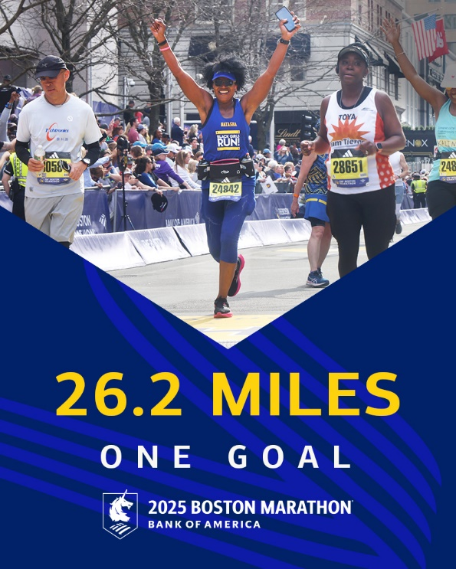
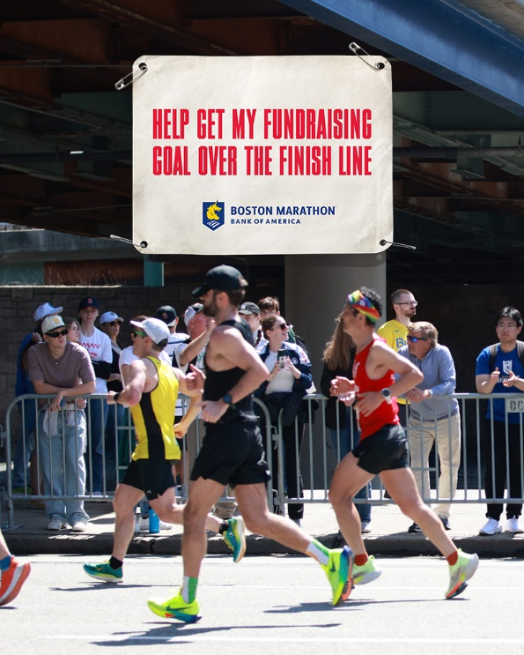
Shareable images
If you’re looking for an image to post, these pre-approved images can be shared on your social media channels and are in the zip folder provided with platform specific sizes.
Option 1
Option 2
Option 3

Slide 15
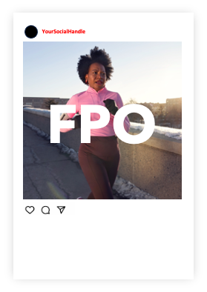
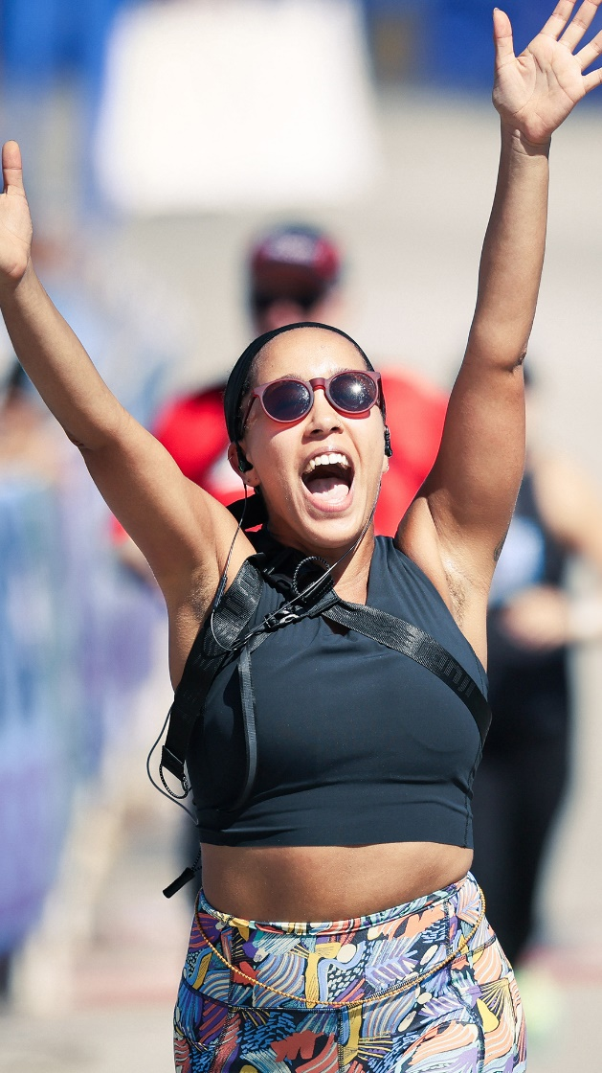
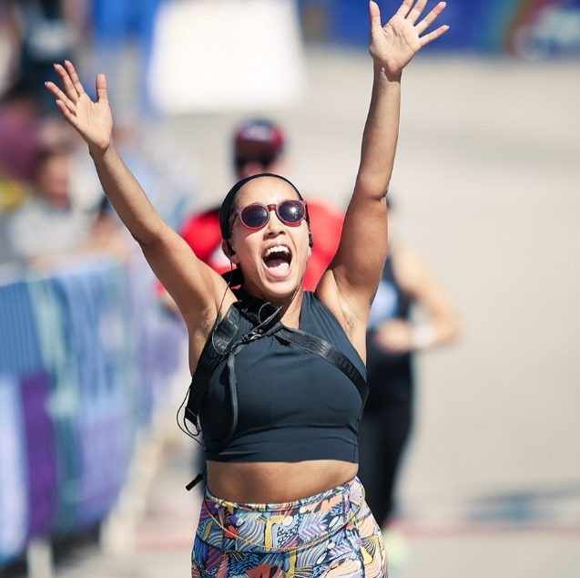


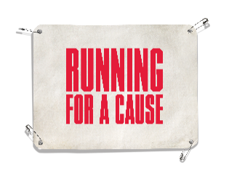

Examples of how it could come to life on your social channels
IG In-Feed Post
IG Story
Add text – play around with fonts, colors, and text backgrounds to draw attention to your content.
YourSocialHandle
Add hashtags – can include hashtags as regular text or use a hashtag sticker.
Add a GIPHY– Include a GIF by tapping the and then select GIF. You can search for Bank of America Boston Marathon stickers by searching the keyword “boston marathon.”
Add a link mention - remember to drive people to the link in your bio to donate to your GivenGain.
YourSocialHandle I'm proud to run for a cause in this year's 129th Boston Marathon
presented by @bankofamerica. My marathon is for @yourcharity. I'm running because ________. Visit the link in my bio to donate if you can! #BostonMarathon #Boston129
Add a link – use link stickers to include your GivenGain page prominently in your content. Plus, you can change the text for the link to be more direct.
Add hashtags – Use official hashtags associated with the race to help with discoverability and reach.

Slide 16
Social Platform Tips

Slide 17
Platform Tips
Facebook
Create fundraising events (either virtual or IRL) to engage your personal network and invite friends & family.
Prioritize Reels/video when you can, but photos are also great! You can also make a Reel out of photos if you want more dynamic content for your profile.
Stories are a great way to send more frequent updates, plus you can include URLs directly in the frame with a Link Sticker.
X (Twitter)
Keep posts short (280 characters) if possible, but you can create a Thread with multiple tweets in one post if you want to tell a longer story at once.
Emojis are a great way to add a little extra to your words!
Include photos/video when possible to add more visually engaging elements to your text updates.
IMPORTANT: Don't forget to include your donation link in your profile bio.
LinkedIn
Engage your professional network with photos/videos related to your story and fundraising journey.

Slide 18
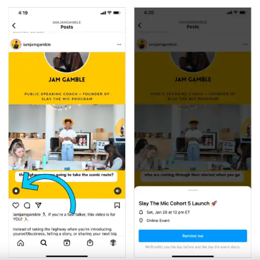
Platform Tips (cont.)
Instagram
Prioritize Reels/video when you can, but photos are also great! You can also make a Reel out of photos if you want more dynamic content for your feed.
Stories are a great way to send more frequent updates and not clutter your profile, plus you can include URLs directly in the frame with a Link Sticker.
  Create a Marathon ‘Highlight’ to save your Stories to so there is longevity of your content even after it expires (after 24hrs).
  Add an alert/reminder to your posts to countdown to race day (see right).
IMPORTANT: Don't forget to include your donation link in your profile bio.
You can also set up a reminder for your friends and family to support you on the day of the Boston Marathon.

Slide 19

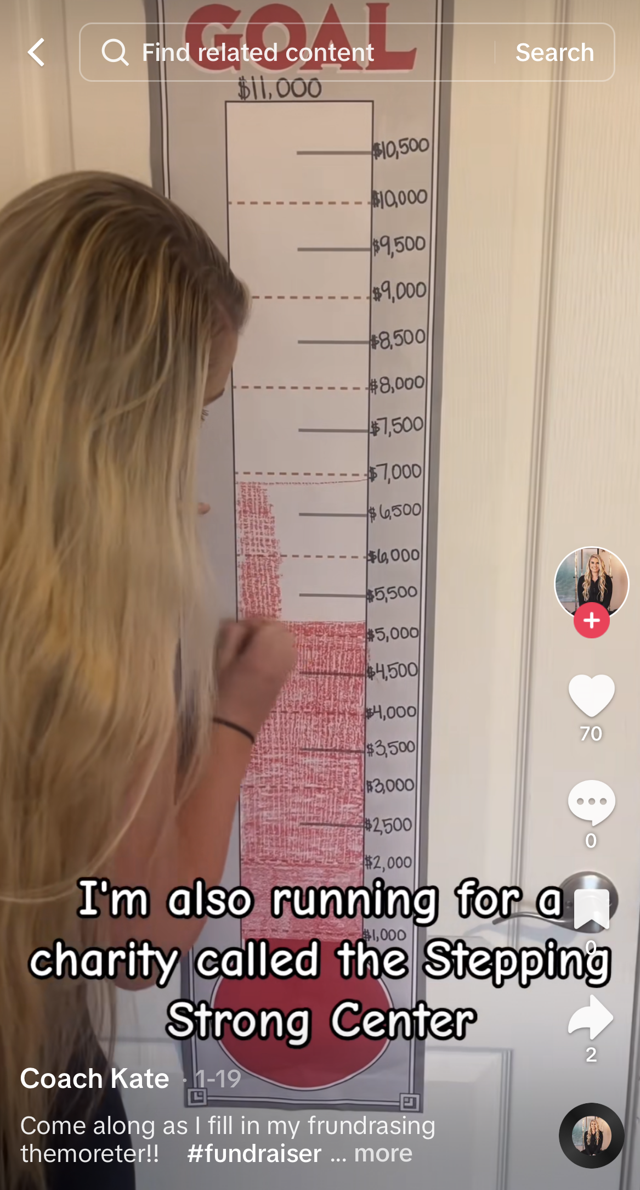
Platform Tips (cont.)
TikTok
Film vertically and keep content short for attention span, although you can film up to 10 mins for a single post.
Use trending sounds & hashtags to help with discoverability and extend the reach of your content.
  Make a video using a series of photos! They'll appear as a carousel in your post...and don't forget to add a relevant or trending sound.
IMPORTANT: Include donation link in your profile bio since TikTok doesn’t support a clickable link in their captions.

Slide 20
Email Template

Slide 21

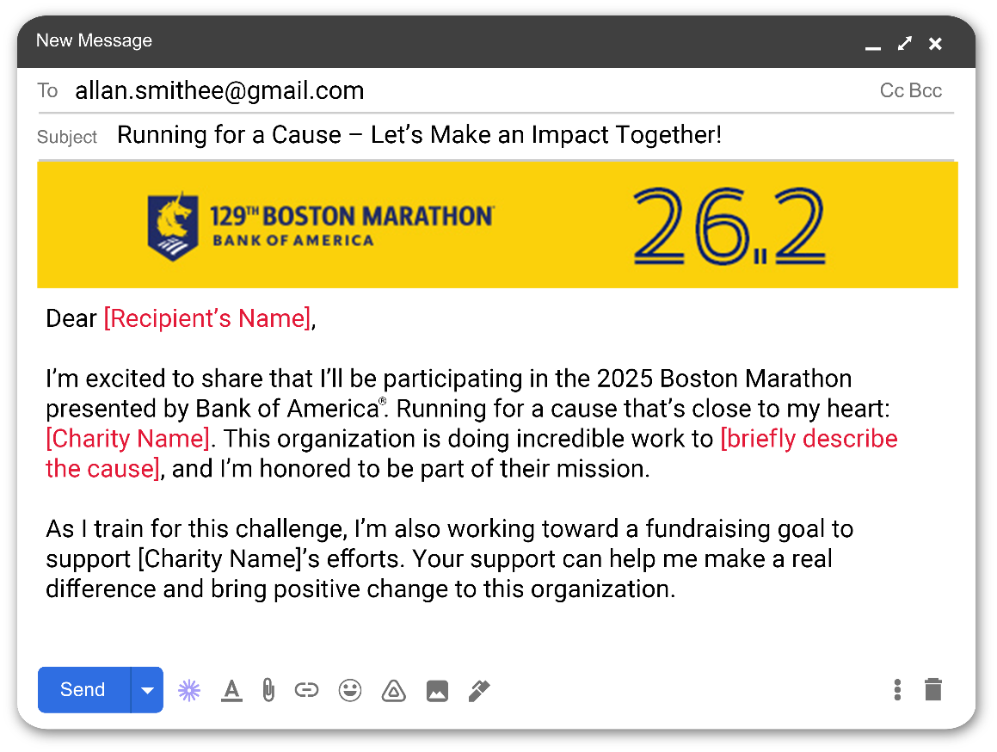
Creating fundraising emails
If you would like to send out an email to friends, family, and potential donors, asking them to support your fundraising efforts by donating, feel free to use the email template that has been included in the attached zip file labeled “Boston_Marathon_EmailTemplate_2025.docx” you can also include the header image provided to the top of your email, labelled “Boston_Marathon_EmailHeader_2025.jpg.” Be sure to fill out all fields highlighted in red.
This email should emphasize your commitment to the cause and encourage recipients to contribute to your charity. It should also include a link to your GivenGain page, making it easy for recipients to donate.
Boston_Marathon_EmailHeader_2025.jpg
Boston_Marathon_EmailTemplate_2025.docx
COMP

Slide 22
Fundraising Thought Starters

Slide 23
Let’s raise some money!
Donation Squares
Create a grid with different amounts and ask people if they want to cover one of the squares and donate that monetary value. Tag users in the photo or post as they start to fill up!
Could also work with big sports games where people purchase blank squares with different numbers across the top of the rows and columns. A winner is determined every half/quarter/period based on the score at that time and their placement in the grid. A portion of the board sales would go to your charity and the other half split with the winners.
Sponsored Runs
Share your training schedule and ask people to ‘sponsor’ one of your upcoming runs. For example, someone could sponsor your long Sunday 10-mile run at $5 per mile which would equal a $50 donation. Share photos/videos from that run and tag your sponsor so they can re-share.
Donation Challenges
Take a page from the viral ALS Ice Bucket Challenge and create a ‘dare’ for your friends and family, tagging them to either complete and/or donate.
Could also work if you set a challenge for yourself and ask people to pledge a donation based on how well you do. For example, you could set a challenge to make 100 basketball free throws and people would send you a dollar amount for every basket made. If you make 82/100, the people that pledged the challenge would send you $82 donations.
Have a separate fundraising event scheduled? Use social media to spread the word and sell tickets beforehand! And don’t forget to share photos/videos from the event to recap and include your donation link in case people missed the event or couldn’t attend.

Slide 24

Good luck fundraising!

Slide 25
Thank You

